Slide 1
Tableau
Representing the data graphically

Slide 2
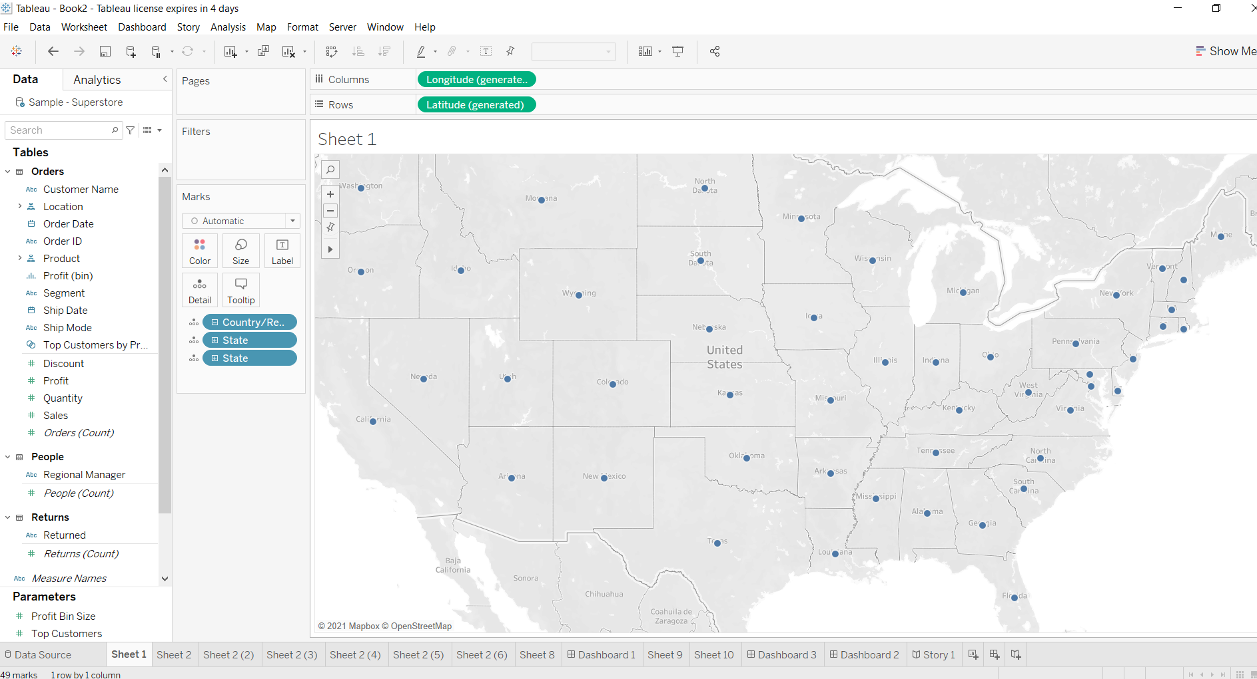
Create a Map view to represent all the states with country.
Double click on state to get the graph

Slide 3
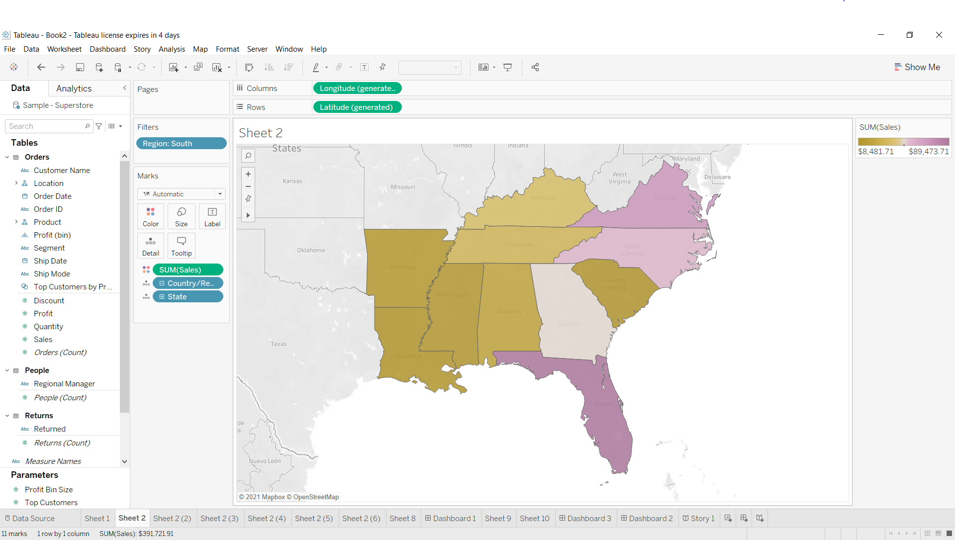
Check your map for south region.
Put region south in the filter option

Slide 4
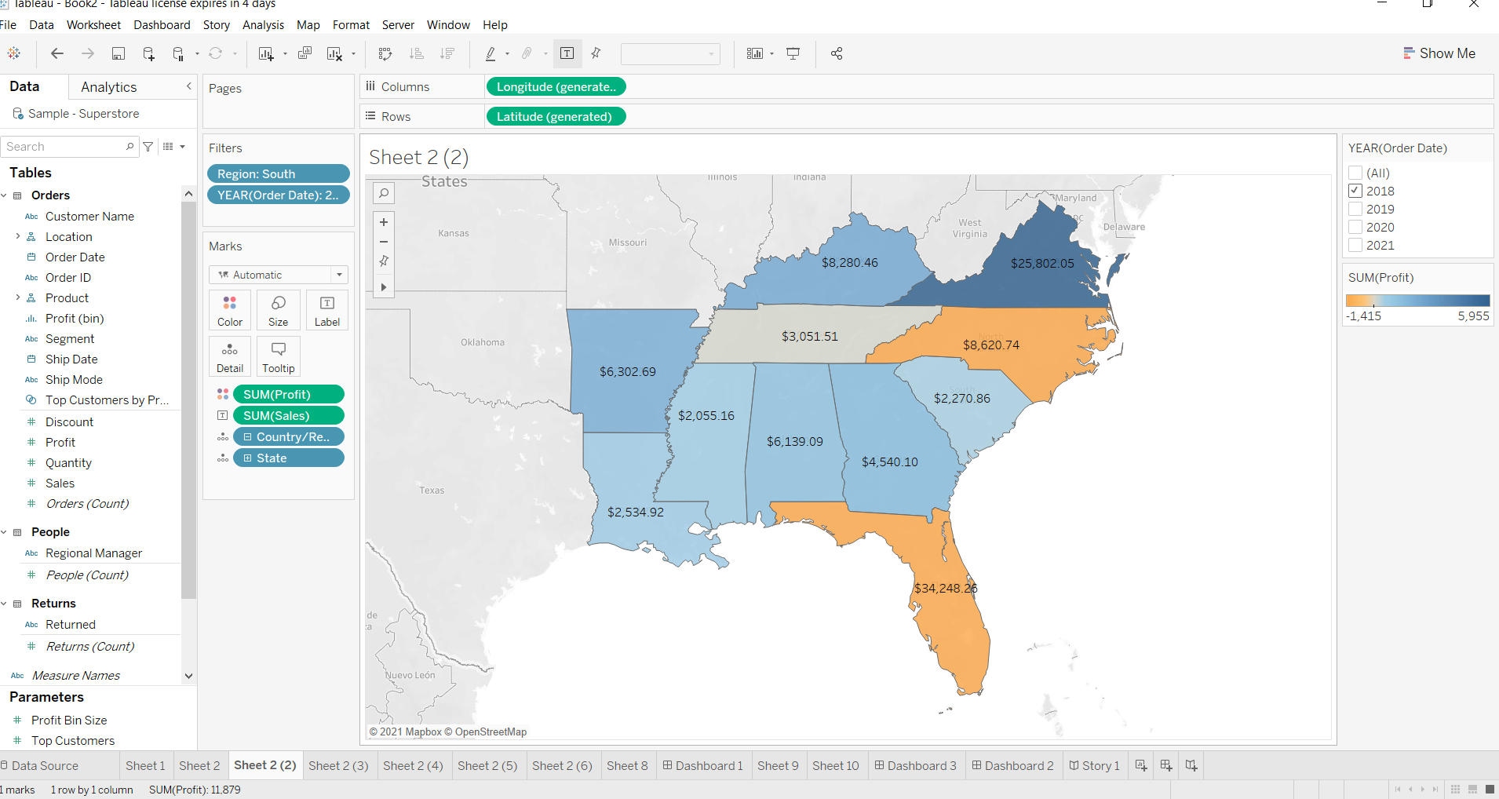
Check the sales for south region.

Slide 5
Find the state that has highest sales.
Country/Region State Latitude Longitude Profit Sales
United States Virginia 37.77 -78.24 5,954.6701 $25,802.05

Slide 6
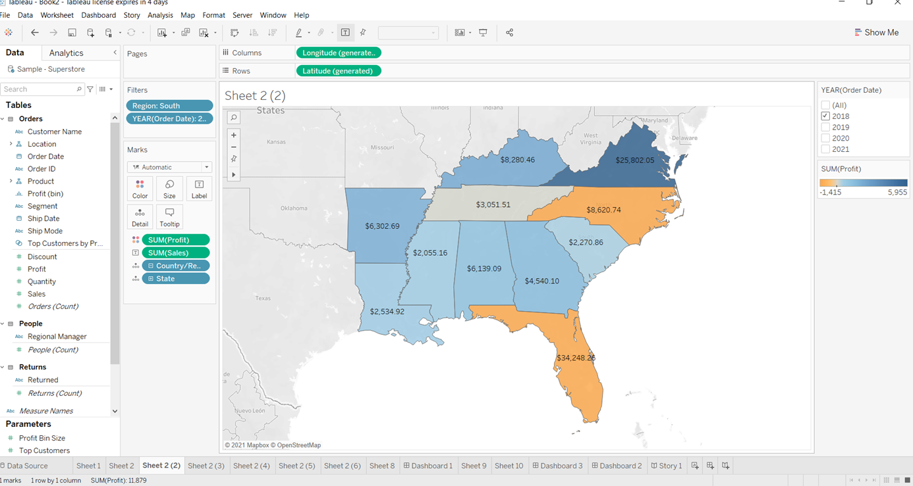
Represent your sales in USD.

Slide 7
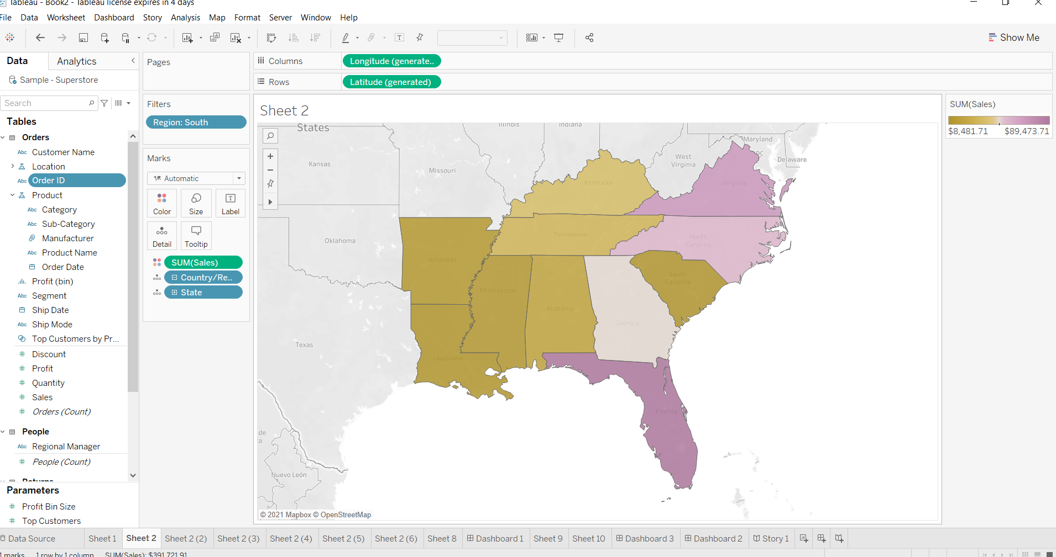
Edit color for you map.

Slide 8
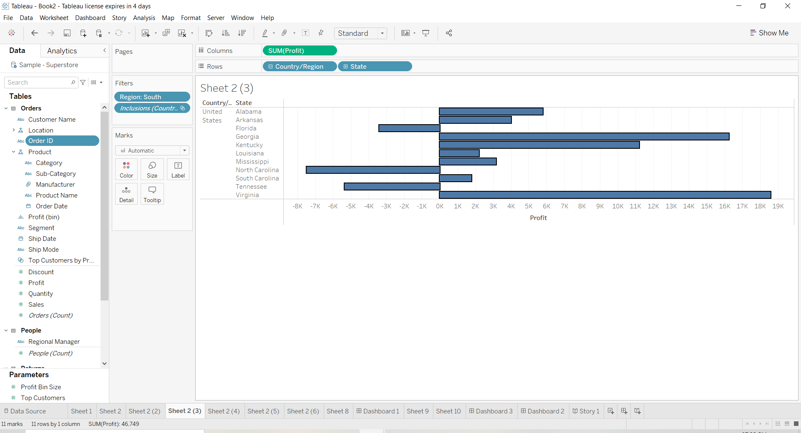
Show profit for all the states in your map in south region.

Slide 9
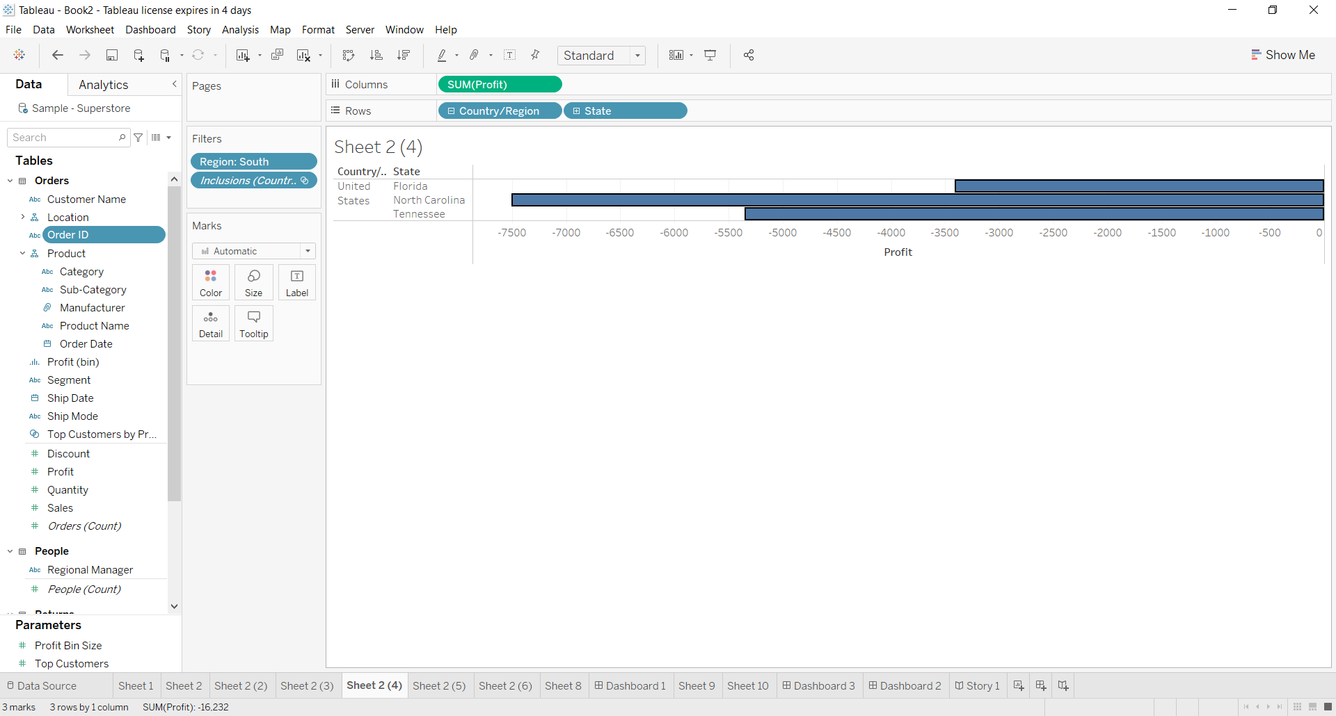
Find out the name of some states having negative profit.

